Slide 1
Data Structures & Algorithms SECP2043
Section P3
Lecture 5
23-11-22

Slide 2
Linked List
A linked list is a collection of components, called nodes.
Every node (except the last node) contains the address of the next node.
Thus, every node in a linked list has two components:
one to store the relevant information (that is, data)
and one to store the address, called the link of the next node in the list.
The address of the first node in the list is stored in a separate location, called the head or first.
The order of the nodes is determined by the address, called the link, stored in each node.

Slide 3
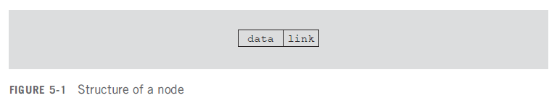
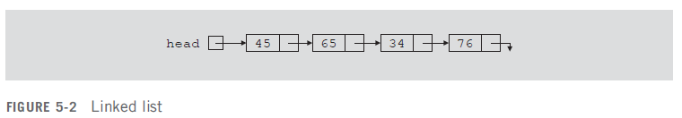

Diagrammatic Representation
The arrow in each node indicates that the address of the node to which it is pointing is stored in that node.
The down arrow in the last node indicates that this link field is NULL.

Slide 4
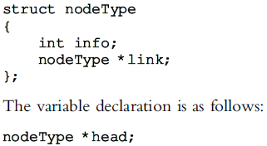
Linked Lists Implementation Through Structures
We need to declare each node as a class or struct as each node of a linked list has two components.
The data type of each node depends on the specific application.
However, the link component of each node is a pointer of node type itself.
For the previous linked list, the definition of the node is as follows. (Suppose that the data type is int.)

Slide 5
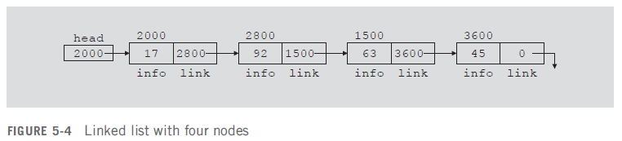
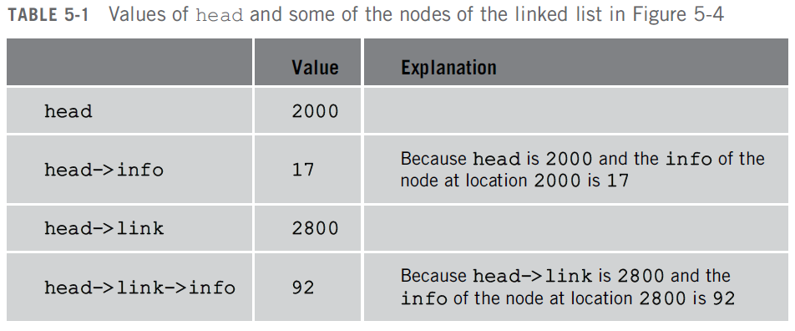
Linked Lists Properties

